Slide 1
Statistical Methods for Data Analysis upper limits
Luca Lista
INFN Napoli

Slide 2
Contents
Upper limits
Treatment of background
Bayesian limits
Modified frequentist approach
(CL_{s} method)
Profile likelihood
Nuisance parameters and
Cousins-Highland approach

Slide 3
Frequentist vs Bayesian intervals
Interpretation of parameter errors:
  θ = θ^{est} ± δ θ ∈[ θ^{est} − δ, θ^{est} + δ]
  θ = θ^{est} ^{+δ2}_{−δ1} θ ∈[ θ^{est} − δ₁, θ^{est} + δ₂]
Frequentist approach:
  Knowing a parameter within some error means that a large fraction (68% or 95%, usually) of the experiments contain the (fixed but unknown) true value within the quoted confidence interval:
  [θ^{est} − δ₁, θ^{est} + δ₂]
Bayesian approach:
  The posterior PDF for θ is maximum at θ^{est} and its integral is 68% within the range [θ^{est} − δ₁, θ^{est}+ δ₂]
The choice of the interval, i.e.. δ₁ and δ₂ can be done in different ways, e.g: same area in the two tails, shortest interval, symmetric error, …
Note that both approaches provide the same results for a Gaussian model using a uniform prior, leading to possible confusions in the interpretation

Slide 4
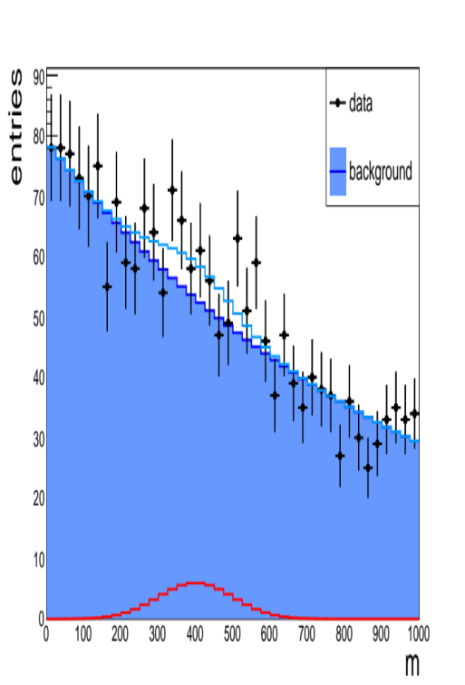
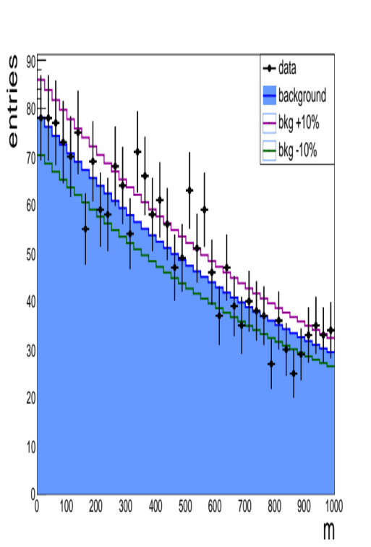
Claiming a discovery
Are data below more consistent with a background fluctuation or with a peaking excess?
We want to test our data sample against two hypotheses about the theoretical underlying model:
  H₀: the data are described by a model that contains background only
  H₁: the data are described by a model that contains signal plus background
Our discrimination is based on a test statistic λ whose distribution is known under the two hypotheses
  Let’s assume λ tends to have (conventionally) large values if H₁ is true and small values if H₀ is true
  This convention is consistent with λ being the likelihood ratio L(x|H₁)/L(x|H₀)
Under the frequentist approach, compute the p-value as the probability that λ is greater or equal to than the value λ_{obs} we observed

Slide 5
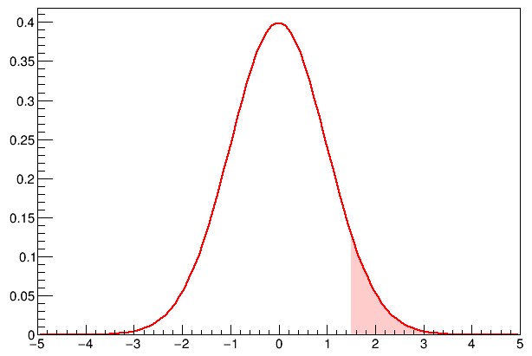
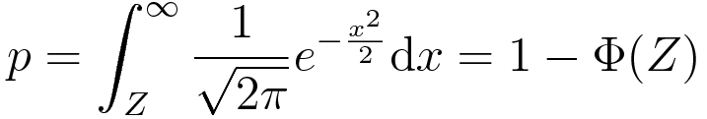

Significance
p-value
The p-value is usually converted into an equivalent area of a Gaussian tail:
Z = significance level
Φ = cumulative of a normal distribution
In literature we find, by convention:
  If the significance is Z > 3 (“3σ”) one claims “evidence of”
    Probability that background fluctuation will produce a test statistic at least as extreme as the observed value : p < 1.349 ⨉ 10⁻³
  If the significance is Z > 5 (“5σ”) one claims “observation” (discovery!)
    p < 2.87 ⨉ 10⁻⁷
Note: the probability that background produces a large test statistic is not equal to probability of the null hypothesis (background only), which has only a Bayesian sense

Slide 6

Statement by
“
  The p-value was never intended to be a substitute for scientific reasoning. Well-reasoned statistical arguments contain much more than the value of a single number and whether that number exceeds an arbitrary threshold. The ASA statement is intended to steer research into a ‘post p < 0.05 era’.
  p-values can indicate how incompatible the data are with a specified statistical model.
  p-values do not measure the probability that the studied hypothesis is true, or the probability that the data were produced by random chance alone.
  Scientific conclusions and business or policy decisions should not be based only on whether a p-value passes a specific threshold.
  Proper inference requires full reporting and transparency.
  A p-value, or statistical significance, does not measure the size of an effect or the importance of a result.
  By itself, a p-value does not provide a good measure of evidence regarding a model or hypothesis.
”
Ronald L. Wasserstein, Nicole A. Lazar
The ASA's statement on p-values: context, process, and purpose
DOI:10.1080/00031305.2016.1154108
http://amstat.tandfonline.com/doi/abs/10.1080/00031305.2016.1154108

Slide 7
Discovery and scientific method
“
From Cowan et al., EPJC 71 (2011) 1554:
It should be emphasized that in an actual scientific context, rejecting the background-only hypothesis in a statistical sense is only part of discovering a new phenomenon. One’s degree of belief that a new process is present will depend in general on other factors as well, such as the plausibility of the new signal hypothesis and the degree to which it can describe the data.
Here, however, we only consider the task of determining the p-value of the background-only hypothesis; if it is found below a specified threshold, we regard this as “discovery”.
”
Complementary role of Frequentist and Bayesian approaches ☺

Slide 8
Discovery and scientific method
“
From Cowan et al., EPJC 71 (2011) 1554:
It should be emphasized that in an actual scientific context, rejecting the background-only hypothesis in a statistical sense is only part of discovering a new phenomenon. One’s degree of belief that a new process is present will depend in general on other factors as well, such as the plausibility of the new signal hypothesis and the degree to which it can describe the data. Here, however, we only consider the task of determining the p-value of the background-only hypothesis; if it is found below a specified threshold, we regard this as “discovery”.
”
Complementary role of Frequentist and Bayesian approaches ☺

Slide 9
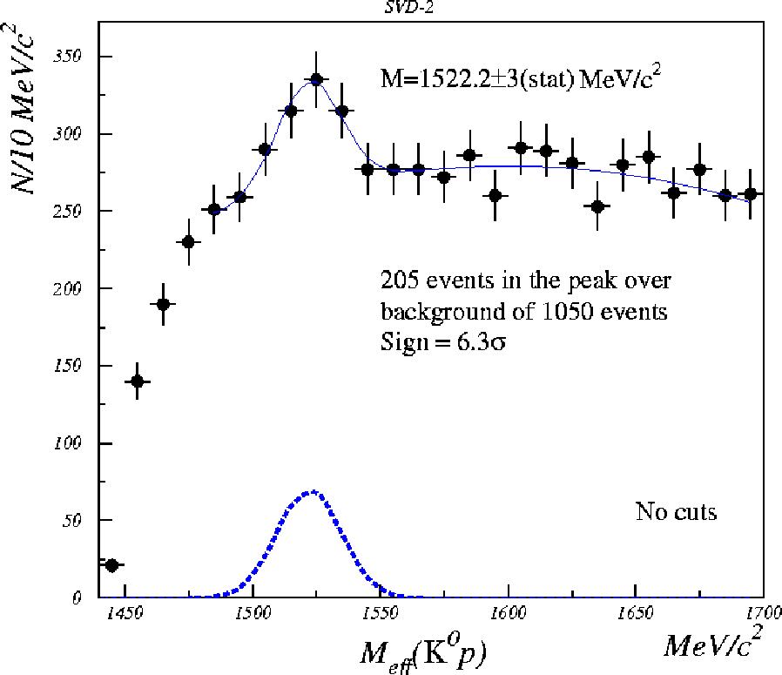
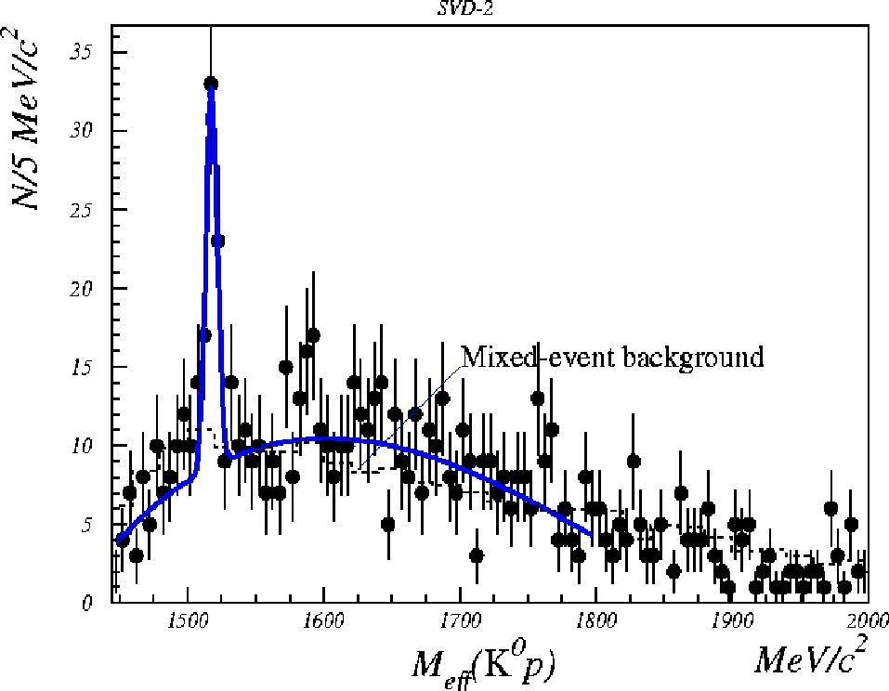
Ascertain physics observations
Are those evidence for pentaquark Θ⁺(1520)→K⁰p?
Influenced by previous evidence papers?
Are there other possible interpretations?
arXiv:hep-ex/0509033v3
10σ significance

Slide 10
Pentaquarks
From PDG 2006, “PENTAQUARK UPDATE” (G.Trilling, LBNL)
“In 2003, the field of baryon spectroscopy was almost revolutionized by experimental evidence for the existence of baryon states constructed from five quarks …
…To summarize, with the exception described in the previous paragraph, there has not been a high-statistics confirmation of any of the original experiments that claimed to see the Θ⁺; there have been two high-statistics repeats from Jefferson Lab that have clearly shown the original positive claims in those two cases to be wrong; there have been a number of other high-statistics experiments, none of which have found any evidence for the Θ⁺; and all attempts to confirm the two other claimed pentaquark states have led to negative results.
The conclusion that pentaquarks in general, and the Θ⁺, in particular, do not exist, appears compelling.”

Slide 11
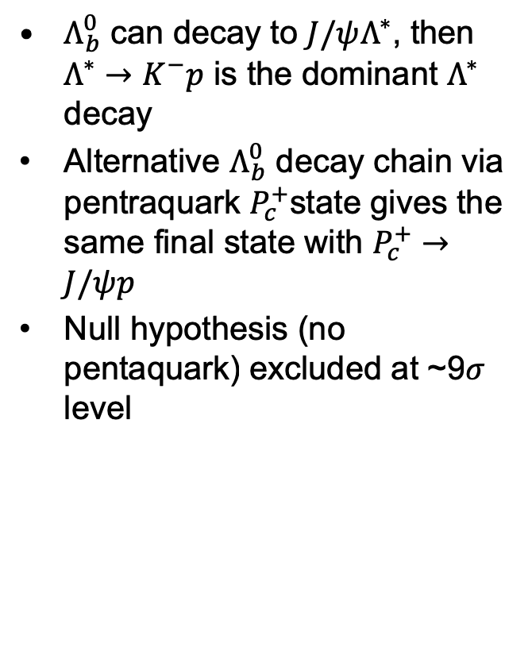

Pentaquark: update from LHCb
$Λ_{b}^{0}$ can decay to $J/ψΛ^{∗}$, then $Λ^{∗}→K^{−}p$ is the dominant $Λ^{∗}$ decay
Alternative $Λ_{b}^{0}$ decay chain via pentraquark $P_{c}^{+}$state gives the same final state with $P_{c}^{+}→J/ψp$
Null hypothesis (no pentaquark) excluded at ~9$σ$ level
Data
Fit with no $P_{c}^{+}$

Slide 12
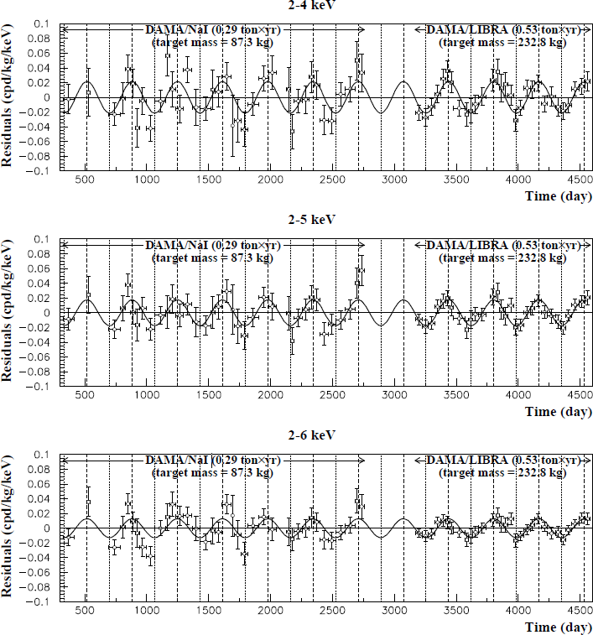
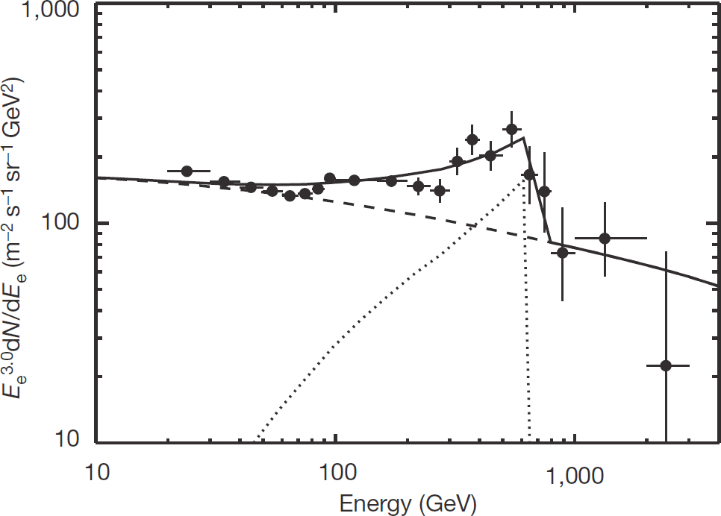
Dark matter search
Are those observations of Dark matter?
Nature 456, 362-365
Eur.Phys.J.C56:333-355,2008

Slide 13
From PDG Review…
“The intervals constructed according to the unified procedure for a Poisson variable n consisting of signal and background have the property that for
n = 0 observed events, the upper limit decreases for increasing expected background. This is counter-intuitive, since it is known that if n = 0 for the experiment in question, then no background was observed, and therefore one may argue that the expected background should not be relevant. The extent to which one should regard this feature as a drawback is a subject of some controversy”

Slide 14
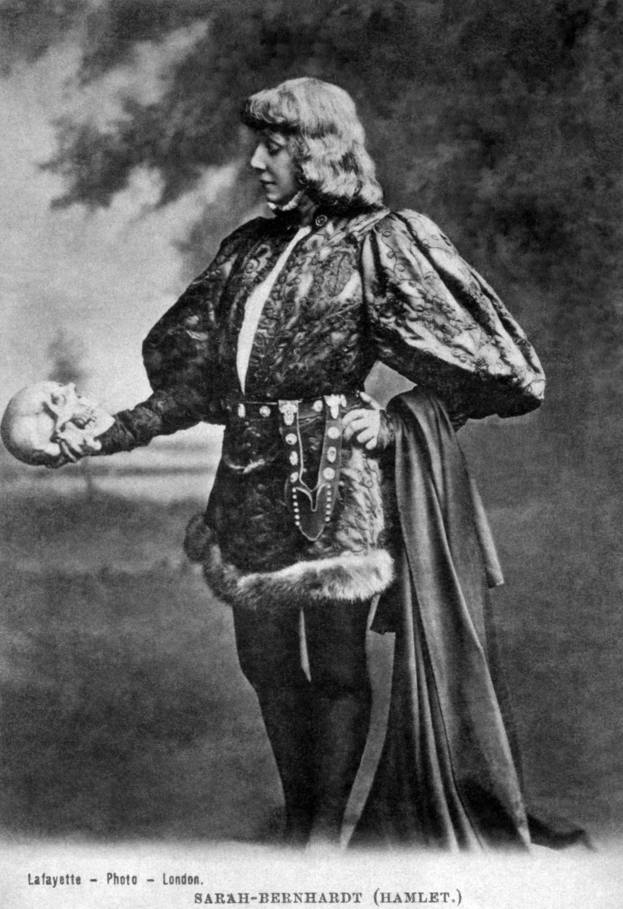
The flip-flopping issue
When to quote a central value or upper limit?
A popular choice was:
  “Quote a 90% CL upper limit
  of the measurement if the
  significance is below 3σ;
  quote a central value otherwise”
  Upper limit ↔ central interval
  decided according to observed
  data
This produces an incorrect
coverage!

Slide 15
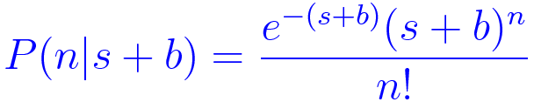
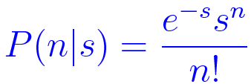
Counting experiments
The only information from our measurements is the number of observed events of the kind of interest
Expected distribution is Poissonian:
Hypotheses test terminology:
  Null hypothesis (H₀): s = 0
  Alternative hypothesis (H₁): test against a specific value of s > 0
An experiment outcome is a specific value of n: n = n_{obs}
If we observe zero events we can state that:
  No background events have been observed (n_{b} = 0)
  No signal events have been observed (n_{s} = 0)
Further simplification: let’s assume that the expected background b is negligible: b ≅ 0

Slide 16
Upper limits for event counting
The simplest search for a new signal consists of counting the number of events passing a specified selection
The number of selected events n is distributed according to a Poissonian distribution
Expected n for signal + background (H₁): s + b
Expected n for background only (H₀): b
We measure n events, we want to compare with the two hypotheses H₁ and H₀.
Simplest case: b is known with negligible uncertainty
  If not, uncertainty on its estimate must be taken into account

Slide 17
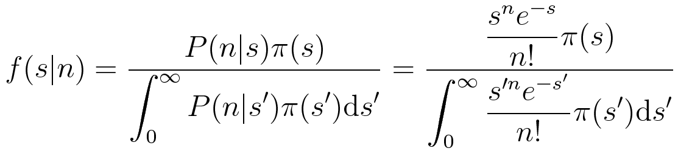
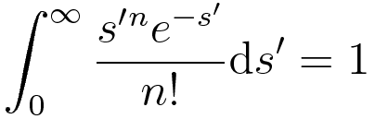
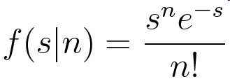



Bayesian inference of a Poissonian
Posterior probability, assuming the prior to be π(s), setting b = 0 for simplicity:
If is π(s) is uniform, the denom. is:
We have: ,
Most probable value:
… but this result depends on the choice of the prior!

Slide 18

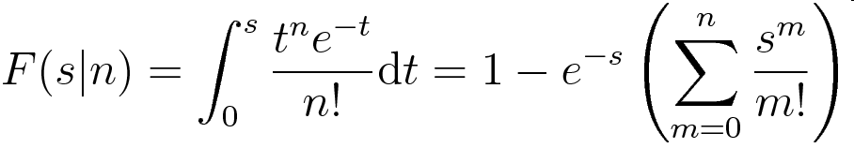



Bayesian upper limit
The posterior PDF for s, assuming a uniform prior, is:
The cumulative distribution is:
In particular for n=0:
We will see that by chance this result
is identical also for a frequentist limit:
But the interpretation is very different!
For zero observed events
f(s|0)
α=5%
0
1
2
3
s

Slide 19
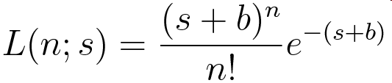
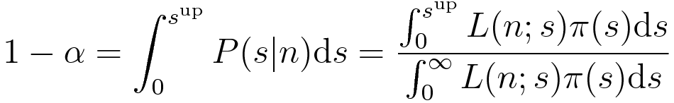

Counting, Bayesian approach
Let’s assume the background b is known with no uncertainty:
A uniform prior, π(s) = 1 simplifies, as usual, the computation:
Inverting the equation giver the
upper limit s^{up}
For n = 0 s^{up} does not depend on b:
  s < 2.303 (90% CL) ← α = 0.1
  s < 2.996 (95% CL) ← α = 0.05

Slide 20
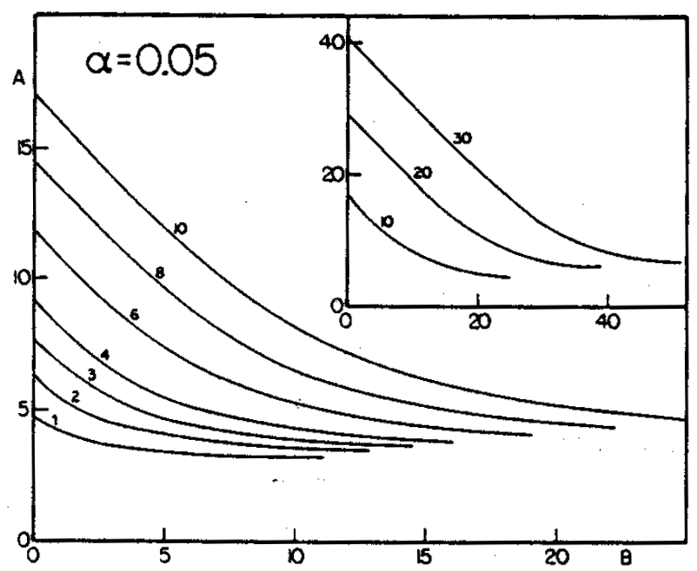
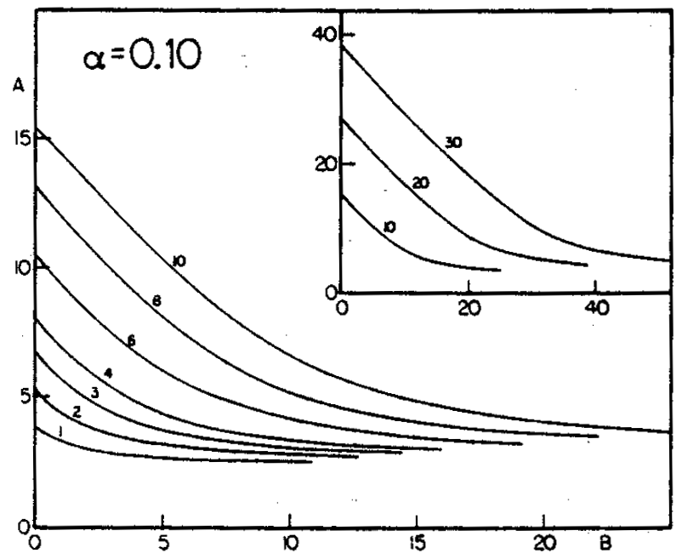
Counting, Bayesian approach
Upper limits decrease as b increases and increase as n increases
For n = 0, upper limits are not sensitive on b (given in prev. slide)
s^{up}
s^{up}
n
n
b
b
  O. Helene. NIMA 212 (1983) 319

Slide 21
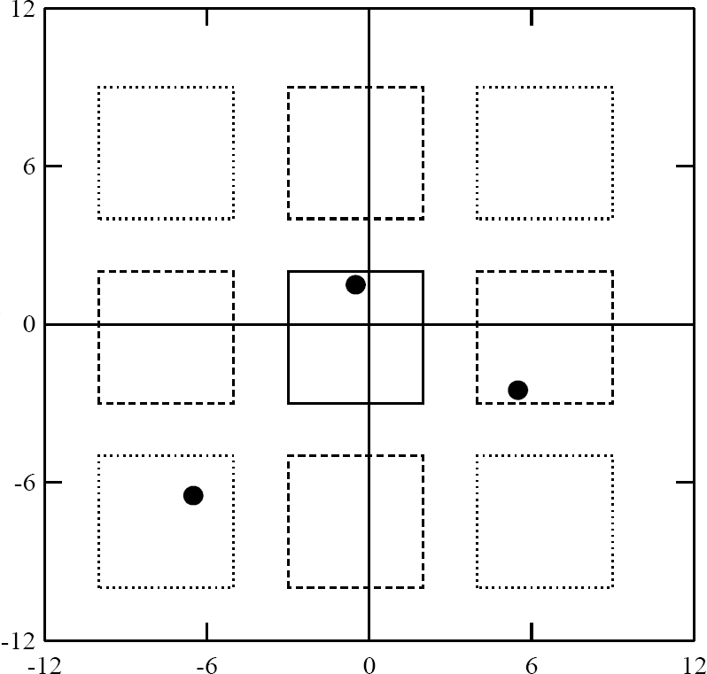
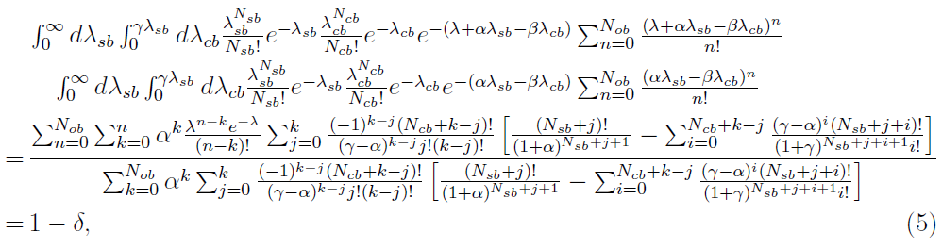

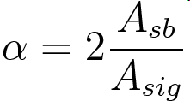
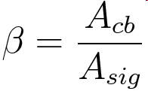
Poissonian background uncertainty
Some analytical derivation reach high level of
complexity
Assume we estimate the background from
sidebands applying scaling factors:
  λ = s = n – b = n − α n_{sb} + β n_{cb}
  sb = “side band”, cb = “corner band”
Upper limit on s with a CL = δ can be as
difficult as:
Numerical treatment is required in many cases!
cb
sb
cb
sb
sb
cb
sb
cb
Physical integration bound:
  K.K. Gan, et al., Nucl. Instr. and Meth. A 412 (1998) 475

Slide 22
Problems of Bayesian limits
Bayesian inference, as well as Bayesian limits, require the choice of a prior distribution
This makes estimates somewhat subjective (some Bayesian supporter use the term “inter-subjective”)
Choices frequently adopted in physics are not unique:
  Uniform PDF as a function of the signal strength?
  Uniform PDF as a function of the Higgs boson mass?
In some cases results do not depend strongly on the assumed prior
  But this usually happens when the statistical sample is sufficiently large, which is not the case often for upper limits

Slide 23
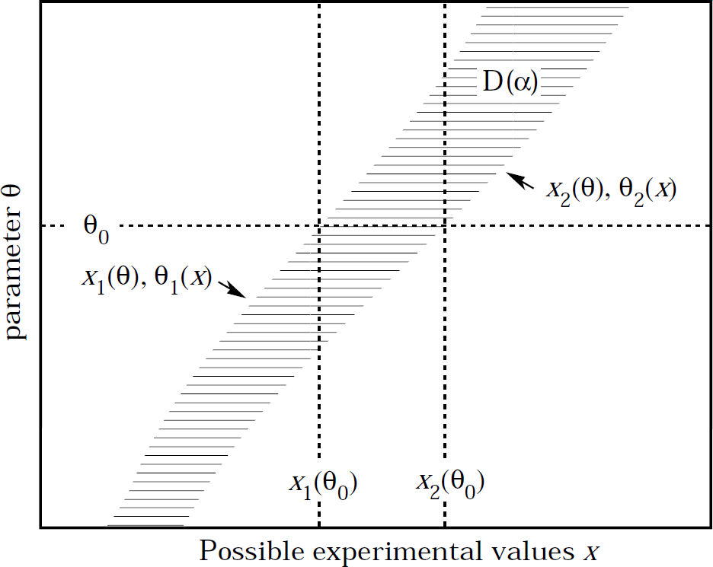
Frequentist upper limits
Upper limit construction from inversion
of Neyman belt with asymmetric intervals
Building a confidence interval on the
observable
  The observable x is the number of events n for
  counting experiments
  Final confidence interval must be asymmetric
  if we want to compute upper limits:
    s ∈ [s₁, s₂] ⇒ s ∈ [0, s^{up}]
  Upper limit = right-most edge of asymmetric
  interval
  Hence, we should have an asymmetric interval on n:
    n ∈ [n₁, n₂] ⇒ n ∈ [n^{min}, ∞]
Poissonian distributions involve discrete values, can’t exactly satisfy coverage: produce the smallest overcoverage
  Use the smallest interval that has at least the desired C.L.:
P(s ∈ [0, s^{up}]) ≥ CL = 1 − α
⇔
P(n ∈ [n^{min}, ∞]) = 1 − p ≥ CL = 1 − α
, θ = s
n^{min} ≤ n ≤ ∞
0 ≤ s ≤ s^{up}
, x = n
s = 4, b = 0
P(n;s)
1 − p ≥ 1−α
p ≤ α
n
Notes:
s^{\mathrm{up}} = \min_{\sum_{n=0}^{n_{\mathrm{obs}}}P(n;s)<\alpha}(s)

Slide 24
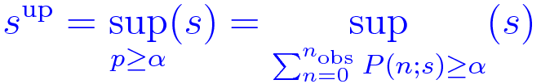

A concrete Poissonian example
Poissonian counting, b = 0
Compute the p.d.f. varying s
  asymmetric for a Poissonian
Determine the probability
1−p corresponding to the
interval [n_{obs,} ∞]
The limit s^{up} is the maximum s
such that 1 − p is greater or equal to CL
(p < α ⇒ excluded; p ≥ α ⇒ allowed):
In case of n_{obs} = 0 the simple formula holds:
s = 4, b = 0
P(n;s)
1−p = 90.84%
p = 9.16%
Lower limit choice
n
What we did intuitively
reflects Neyman’s construction.
By chance identical to Bayesian
result
Notes:
s^{\mathrm{up}} = \sup_{p\ge\alpha}(s) = \sup_{\sum_{n=0}^{n_{\mathrm{obs}}}P(n; s)\ge\alpha}(s)

Slide 25
Excluding a signal hypothesis
Assuming a given value of s > 0 (H₁), a corresponding p-value can be computed
in this case the p-value measures the probability of a signal underfluctuation (n ≤ n_{obs} )
  Null hypothesis is inverted w.r.t. the discovery case
The exclusion of a signal hypothesis usually has milder requirements:
  p < 0.05 (i.e.: 95% confidence level): Z = 1.64
  p < 0.10 (i.e.: 90% confidence level): Z = 1.28
Discovering a new signal usually requires more stringent evidence than excluding it!

Slide 26
Frequentist: zero events selected
Assume we have negligible background (b = 0) and we measure zero events (n = 0)
The likelihood function simplifies as:
The (fully asymmetric) Neyman belt inversion is pretty simple:
The results are by chance identical to the Bayesian computation:
  s < 2.303 (90% CL) ← α = 0.1
  s < 2.996 (95% CL) ← α = 0.05
In spite of the numerical coincidence, the interpretation of frequentist and Bayesian upper limits remain very different!
Warning: this evaluation suffer from the “flip-flopping” problem, so the coverage is spoiled if you decide to switch from upper limit to a central value depending on the observed significance!

Slide 27
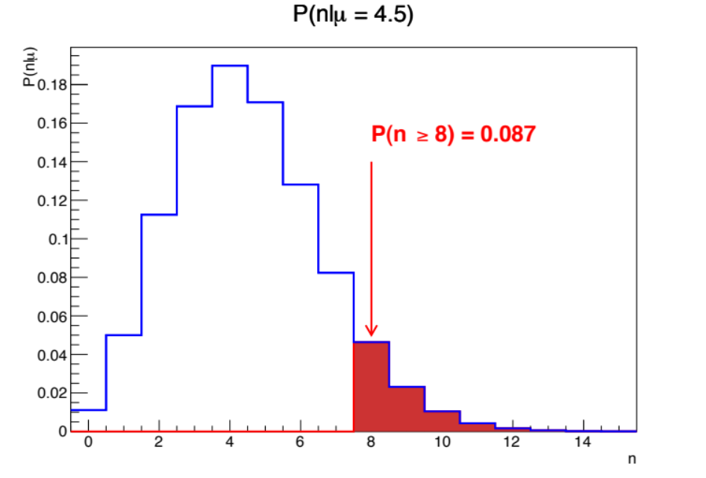
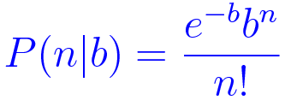
Frequentist: p-value
p-value: probability to observe at least n_{obs} events if the null hypothesis H₀ (s = 0) is true
Probability that a background (over)fluctuation gives at least the observed number of events
If H₀ is true (s = 0) the distribution of the p-value is uniform if the distribution is continuous. It is approximately uniform in case of discrete distributions
Remark: the p-value is not the probability that H₀ is true: this is probability has meaning only under the Bayesian approach!
b = 4.5

Slide 28
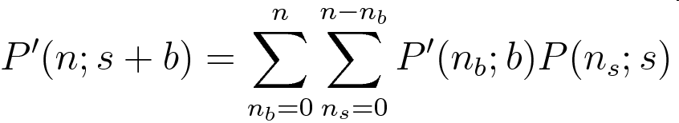
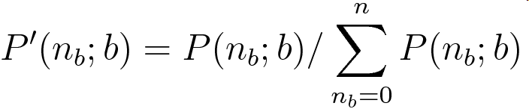
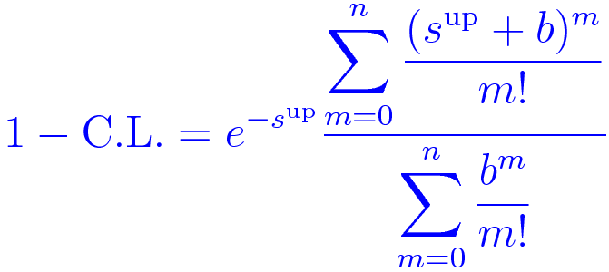
Zech’s “frequentist” interpretation
Proposed attempt to derive Helene’s formula under a frequentist approach
Restrict the probability to the observed condition that the number of background events does not exceed the number of observed events
“In an experiment where b background events are expected and n events are found,
P(n_{b};b) no longer corresponds to our improved knowledge of the background distributions. Since n_{b} can only take the numbers n_{b} ≤ n, it has to be renormalized
to the new range of n_{b}:
  ”
Leads to a result identical
to the Bayesian approach!
Zech’s frequentist derivation
attempted was criticized by Highlands:
does not ensure the proper coverage
Often used in a “pragmatic” way, and recommended for some
time by the PDG
G. Zech, Nucl. Instr. and Meth. A 277 (1989) 608-610

Slide 29
Zech’s derivation references
Bayesian solution found first proposed by O.Helene
  O. Helene. Nucl. Instr. and Meth. A 212 (1983), p. 319 Upper limit of peak area (Bayesian)
Attempt to derive the same conclusion with a frequentist approach
  G. Zech, Nucl. Instr. and Meth. A 277 (1989) 608-610 Upper limits in experiments with background or measurement errors
Frequentist validity criticized by Highland
  V.L. Highland Nucl. Instr. and Meth. A 398 (1989) 429-430 Comment on “Upper limits in experiments with background or measurement errors” [Nucl. Instr. and Meth. A 277 (1989) 608–610]
Zech agreement that his derivation is not rigorously frequentist
  G. Zech, Nucl. Instr. and Meth. A 398 (1989) 431-433 Reply to ‘Comment on “Upper limits in experiments with background or measurement errors” [Nucl. Instr. and Meth. A 277 (1989) 608–610]’
Cousins overview and summary of the controversy
  Workshop on Confidence Limits, 27-28 March, 2000, Fermilab

Slide 30
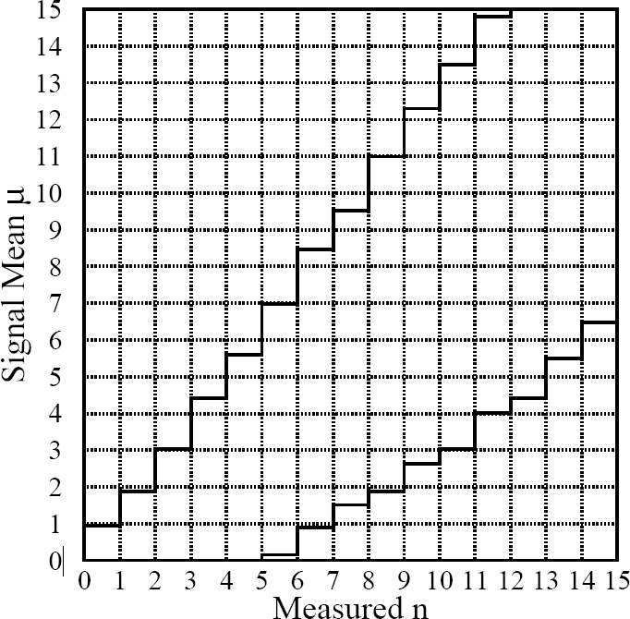
Feldman-Cousins: Poissonian case
b = 3,
90% C.L.
Purely frequentist
ordering based on
likelihood ratio
Belt depends on b,
of course
G.Feldman, R.Cousins,
Phys.Rev.D,57(1998),
3873

Slide 31
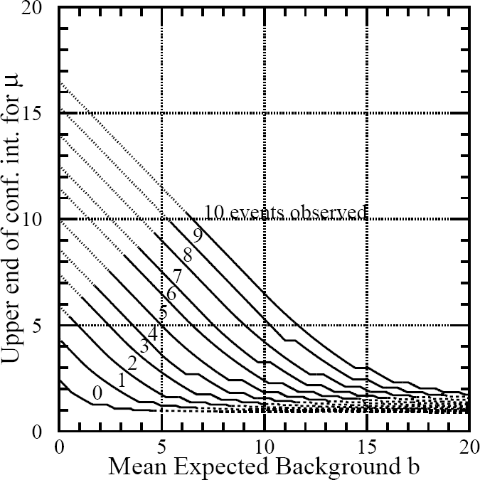
Upper limits with Feldman-Cousins
90% C.L.
Note that the curve for
n = 0 decreases with b,
while the result of the
Bayesian calculation
is independent on b,
at 2.3
F&C reply:
frequentist interval
do not express P(μ|x) !
G.Feldman, R.Cousins,
Phys.Rev.D,57(1998),
3873

Slide 32
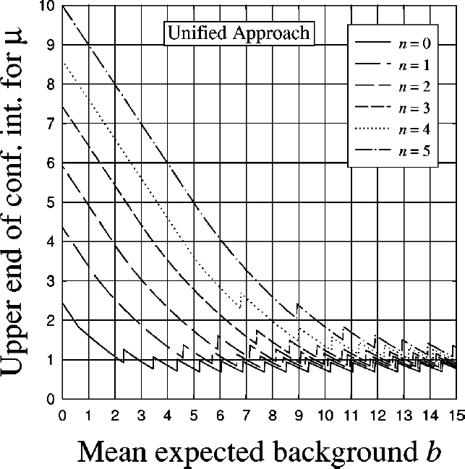
A Close-up
Note the ‘ripple’
Structure due to the discrete nature of Poissonian statistics
C. Giunti,
Phys.Rev.D,59(1999),
053001

Slide 33
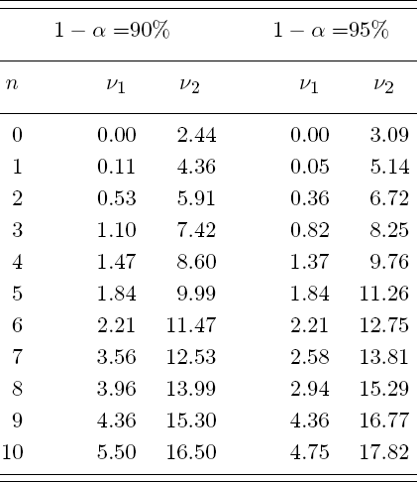
Limits in case of no background
From PDG
“Unified” (i.e.: Feldman-Cousins) limits for Poissonian counting in case of no background are larger than Bayesian limits

Slide 34
Pros and cons of F&C approach
Pros:
  Avoids problems with physical boundaries on parameters
  Never returns an empty confidence interval
  Does not incur flip-flop problems
  Ensure proper statistical coverage
Cons:
  Constructing the confidence intervals is complicated, requires numerical algorithms, and very often CPU-intensive toy Monte Carlo generation
  Systematic uncertainties are not easily to incorporate
  Peculiar features with small number of events
  In case of zero observed events, gives better limits for experiments that expect higher background

Slide 35
Problems of frequentist methods
The presence of background may introduce problems in interpreting the meaning of upper limits
A statistical under-fluctuation of the background may lead to the exclusion of a signal of zero at 95% C.L.
  Unphysical estimated “negative” signal?
“tends to say more about the probability of observing a similar or stronger exclusion in future experiments with the same expected signal and background than about the non-existence of the signal itself” [*]
What we should derive, is just that there is not sufficient information to discriminate the b and s+b hypotheses
When adding channels that have low signal sensitivity may produce upper limits that are severely worse than without adding those channels
[*] A. L. Read, Modified frequentist analysis of search results
(the CLs method), 1st Workshop on Confidence Limits, CERN, 2000

Slide 36
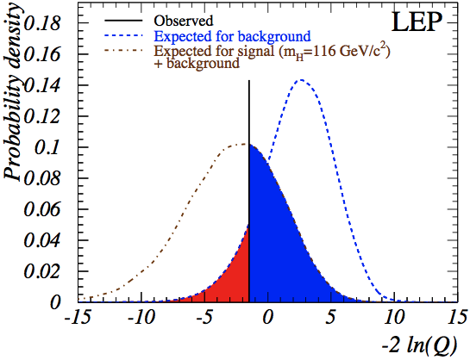
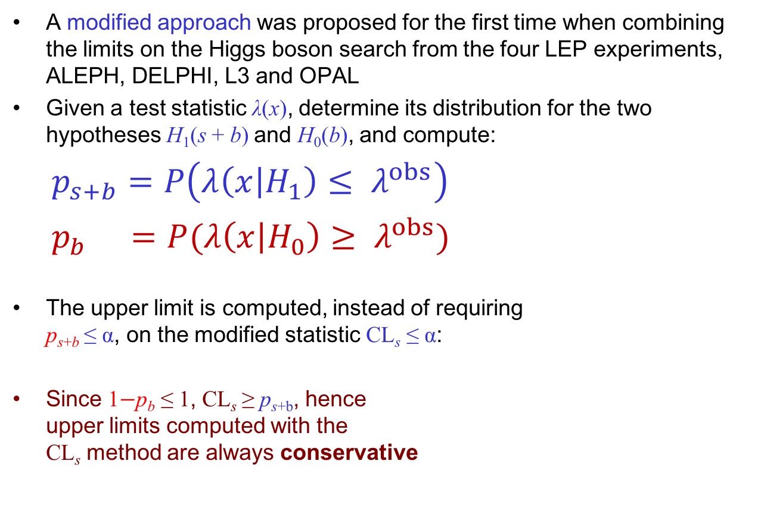
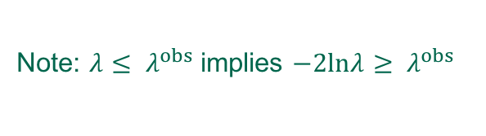
Modified frequentist approach
A modified approach was proposed for the first time when combining the limits on the Higgs boson search from the four LEP experiments, ALEPH, DELPHI, L3 and OPAL
Given a test statistic λ(x), determine its distribution for the two hypotheses H₁(s + b) and H₀(b), and compute:
$p_{s+b}$ $=P\left(λ\left(x | H_{1}\right)≤ λ^{obs}\right)$
$p_{b}$ $=P(λ\left(x | H_{0}\right)≥ λ^{obs})$
The upper limit is computed, instead of requiring
p_{s+b} ≤ α, on the modified statistic CL_{s} ≤ α:
Since 1$−$p_{b} ≤ 1, CL_{s} ≥ p_{s+b}, hence
upper limits computed with the
CL_{s} method are always conservative
p_{s+b}
p_{b}
−2 ln λ
Note: $λ≤ λ^{obs}$ implies $−2lnλ≥ λ^{obs}$

Slide 37
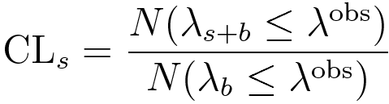
CL_{s} with toy experiments
In practice, p_{b} and p_{s+b} are computed in from simulated pseudo-experiments (“toy Monte Carlo”)
Plot from LEP Higgs combination paper
−2 ln λ

Slide 38
Main CL_{s} features
exp.
for s+b
exp.
for b
p_{s+b}: probability to obtain a result which is less compatible with the signal than the observed result, assuming the signal hypothesis
p_{b}: probability to obtain a result less compatible with the background-only hypothesis than the observed one
If the two distributions are very well separated ad H₁ is true, than p_{b} will be very small ⇒
1−p_{b} ~ 1 and CL_{s} ~ p_{s+b}, i.e: the ordinary p-value of the s+b hypothesis
If the two distributions largely overlap, than if p_{b} will be large ⇒ 1 − p_{b} small, preventing CL_{s} to become very small
CL_{s} < 1 − α prevents rejecting cases where the experiment has little sensitivity
p_{b} ~ 0
p_{s+b} ~ CL_{s}
−2ln λ
exp.
for s+b
exp.
for b
p_{b} ~ 1
p_{s+b} < CL_{s}
−2ln λ

Slide 39
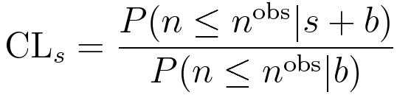
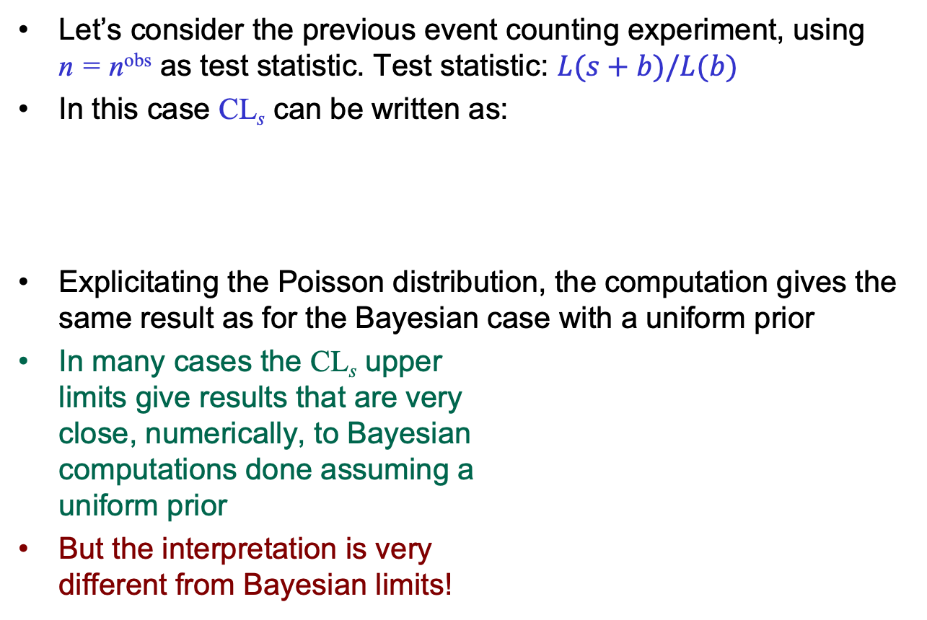
Event counting with CL_{s}
Let’s consider the previous event counting experiment, using
n = n^{obs} as test statistic. Test statistic: $L(s+b)/L(b)$
In this case CL_{s} can be written as:
Explicitating the Poisson distribution, the computation gives the same result as for the Bayesian case with a uniform prior
In many cases the CL_{s} upper
limits give results that are very
close, numerically, to Bayesian
computations done assuming a
uniform prior
But the interpretation is very
different from Bayesian limits!

Slide 40
Observations on the CL_{s} method
“A specific modification of a purely classical statistical analysis is used to avoid excluding or discovering signals which the search is in fact not sensitive to”
“The use of CLs is a conscious decision not to insist on the frequentist concept of full coverage (to guarantee that the confidence interval doesn’t include the true value of the parameter in a fixed fraction of experiments).”
“confidence intervals obtained in this manner do not have the same interpretation as traditional frequentist confidence intervals nor as Bayesian credible intervals”
A. L. Read, Modified frequentist analysis of search results
(the CLls method), 1st Workshop on Confidence Limits, CERN, 2000

Slide 41
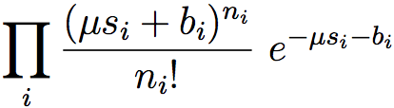

General likelihood definition
The exact definition of the likelihood function depends on the data model “format”. In general:
Binned case (histogram):
Unbinned case (signal/background PDFs):
signal strength
nuisance parameters
PDF, typically Gaussian,
log-normal, flat

Slide 42
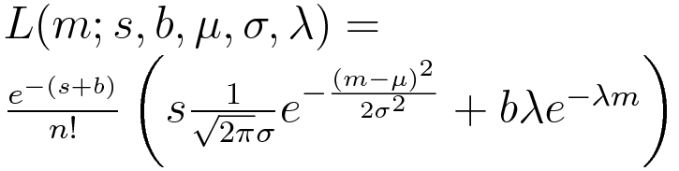
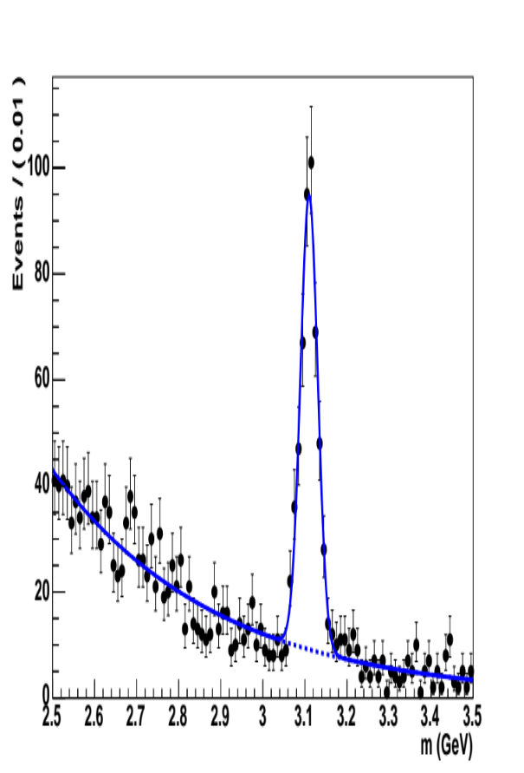
Nuisance parameters
Usually, signal extraction procedures (fits, upper limits setting) determine, together with parameters of interest, also nuisance parameters that model effects not strictly related to our final measurement
  Background yield and shape
  parameters
  Detector resolution
  ...
Nuisance parameters are also used
to model sources of systematic
uncertainties
Often referred to nominal values
  Examples:
  b = β σ_{b} L_{int} with β^{nominal} = 1
  b = e^{β} σ_{b} L_{int} with β^{nominal} = 0
  (negative yields not allowed!)
cross section ⨉ int. lumi

Slide 43
Nuisance parameters
So called “nuisance parameters” are unknown parameters that are not interesting for the measurement
  E.g.: detector resolution, uncertainty in backgrounds, background shape modeling, other systematic uncertainties, etc.
Two main possible approaches:
Add the nuisance parameters together with the interesting unknown to your likelihood model
  But the model becomes more complex!
  Easier to incorporate in a fit than in upper limits
“Integrate it away” (→ Bayesian)

Slide 44
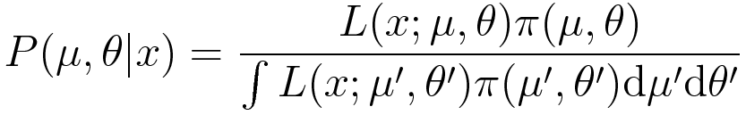
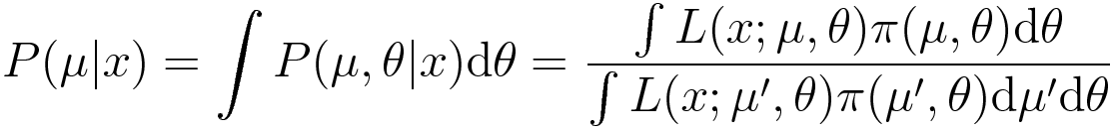
Nuisance pars in Bayesian approach
Notation below: μ = parameter(s) of interest,
θ = nuisance parameter(s)
No special treatment:
P(μ|x) obtained as marginal PDF of μ obtained integrating on θ:

Slide 45
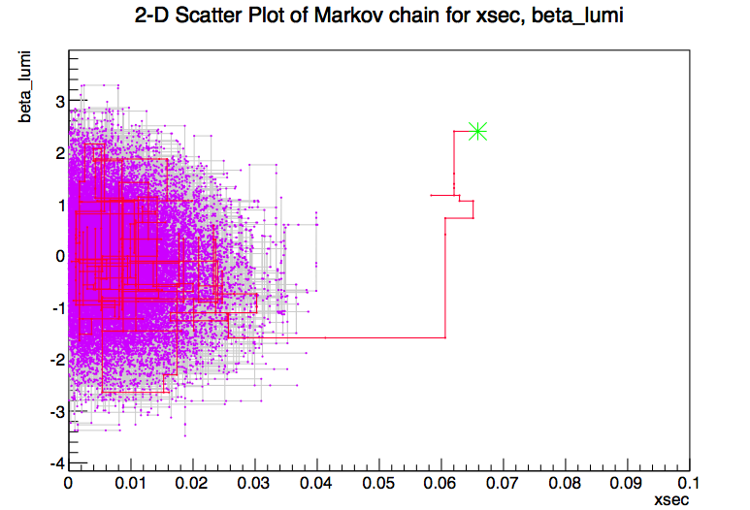
How to compute Posterior PDF
Perform analytical integration
  Feasible in very few cases
Use numerical integration
  May be CPU intensive
Markov Chain Monte Carlo
  Sampling parameter space efficiently using a random walk heading to the regions of higher probability
  Metropolis algorithm to sample according to a PDF f(x)
    Start from a random point, x_{i}, in the parameter space
    Generate a proposal point x_{p} in the vicinity of x_{i}
    If f(x_{p}) > f(x_{i}) accept as next point x_{i}+1 = x_{p}
    else, accept only with probability p = f(x_{p}) / f(x_{i})
    Repeat from point 2
  Convergence criteria and step size
  must be defined
RooStats::BayesianCalculator
RooStats::MCMCCalculator

Slide 46
Nuisance pars., frequentist
Introduce a complementary dataset to constrain the nuisance parameters θ (e.g.: calibration data, background estimates from control sample…)
Formulate the statistical problem in terms of both the main data sample (x) and the control sample (y)
Not always the control sample data are available
  E.g.: calibration from test beam, stored in different formats, control samples analyzed with different software framework…
  In some cases may be complex and CPU intensive
Simplest case; assume known PDF for “nominal” value of θ^{nom}
(e.g.: estimate with Gaussian uncertainty)

Slide 47
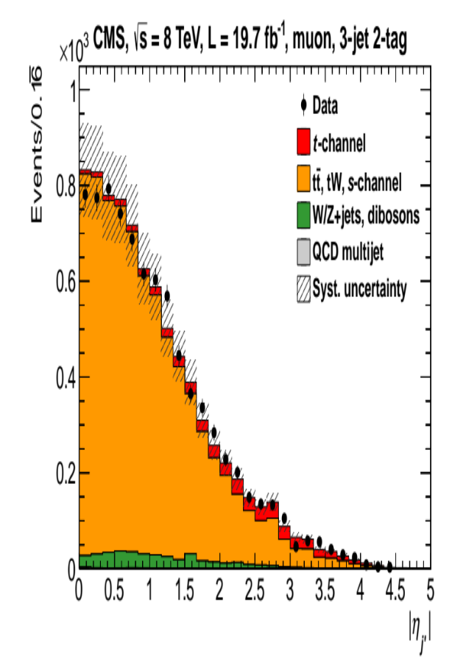
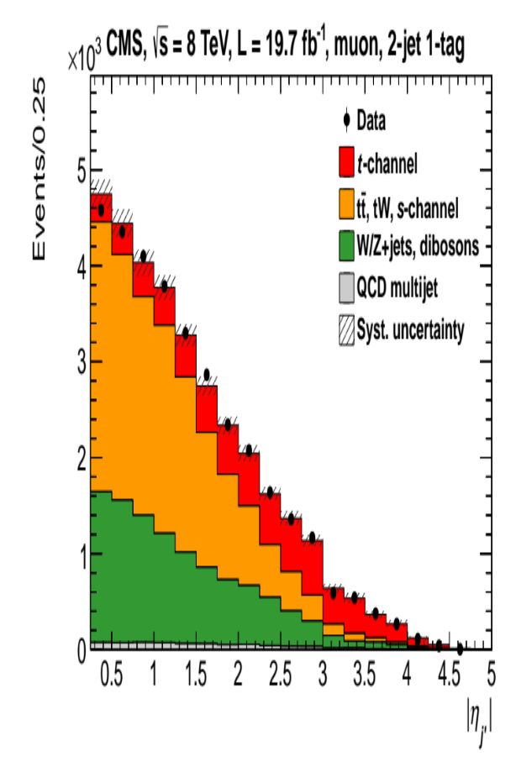
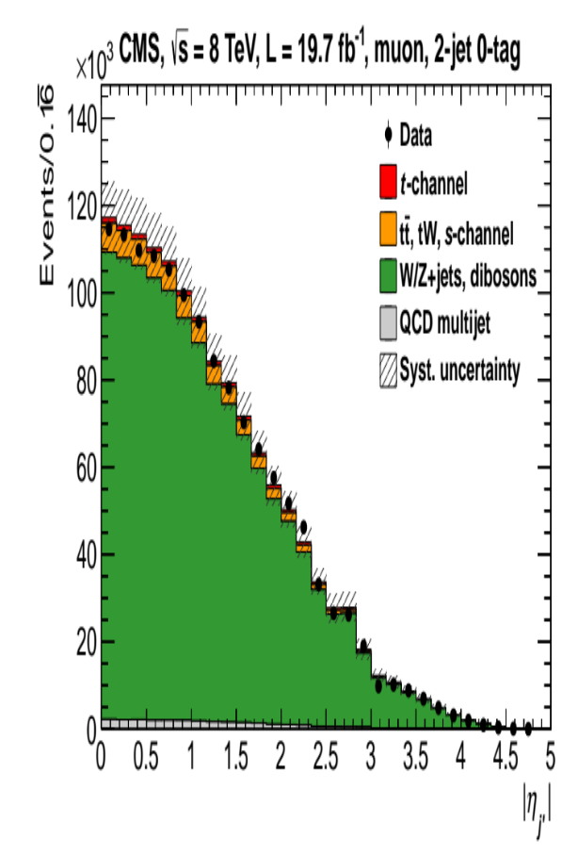

Fitting control regions
In some cases, background parameters can be constrained from statistically independent control samples
  Consider possible signal contamination!
Background yield can be measured in background-enriched regions and extrapolated to signal regions applying scale factors predicted by simulation
Complete likelihood function = product of likelihood functions in each considered regions, sharing common nuisance parameters
  Typically: background rates
$t\overline{t}$ enriched region:
one extra jet required
Measurement of single-top production at LHC
Signal region:
two jets, one b tagged
W+jets enriched region
no b-tagged jet

Slide 48

Cousins-Highland hybrid approach
Method proposed by Cousins and Highland
  Add posterior from another experiment into the likelihood definition
  Integrate the likelihood function over the nuisance parameters
Also called “hybrid” approach, because a partial Bayesian approach is implicit in the integration
  Bayesian integration of PDF, then likelihood used in a frequentist way
Not guaranteed to provide exact frequentist coverage!
Numerical studies with pseudo experiments showed that the hybrid CL_{s} upper limits gives very similar results to Bayesian limit assuming a uniform prior
  NIM A320 (1992) 331-335

Slide 49

Profile likelihood
Define a test statistic based on a likelihood ratio:
μ is usually the “signal strength” (i.e.: σ/σ_{th}) in case of a search for a new signal
Different ‘flavors’ of test statistics
  E.g.: deal with unphysical μ < 0, …
The distribution of q_{μ} = −2 ln λ(μ) may be asymptotically approximated to the distribution of a χ² with one degree of freedom (one parameter of interest = μ) due to the Wilks’ theorem
(→ next slide)
Fix μ, fit θ
Fit both μ and θ

Slide 50




Wilks’ theorem (1938)
Consider a likelihood function from N measurements:
Assume that H₀ and H₁ are two nested hypotheses, i.e.: they can be expressed as:
Where Θ₀ ⊆ Θ₁. Then, the following quantity for N→∞ is distributed as a χ² with n.d.o.f. equal to the difference of Θ₀ and Θ₁ dimensionality:
E.g.: searching for a signal with strength μ, H₀: μ = 0, H₁: μ ≥ 0 we have the profile likelihood (supremum = best fit value):

Slide 51


A realistic case
A variable (e.g.: reconstructed invariant mass) is samples for a number of events
It’s distribution is used to look for a signal
Null hypothesis (H₀)
Signal hypothesis (H₁)

Slide 52



Bump hunting
Significance evaluation can be performed by generating random pseudo-experiments (“toy MC”)
$t = −2ln⁡(L(s+b)/L(b))$
p-value estimated as the fraction of toys with value of t greater than t_{obs}.
Signal
assumed
t_{obs}
No signal
assumed
In the presented case, assuming no nuisance parameter (μ is the only parameter of the model):
p = 374/10⁵ = 3.7±0.2%
Z = 2.7

Slide 53

Determining the signal strength
A scan of the test statistics reveals its minimum at the best parameter value (μ=signal strength here)
The fit value of μ is the maximum-likelihood estimate
  μ = 1.24^{+0.49}_{-0.48}
Using the likelihood ratio instead of just the likelihood: from Wilk’s theorem, the likelihood ratio approximately follows
a χ² distribution in the null
hypothesis
  In presence of signal:
    Significance Z ~ √-t_{min}
    In this case Z ~ 2.7
  Goodness-of-fit, in case of
  no presence of signal

Slide 54


Dealing with systematics
Several assumptions done in the model are affected by systematic uncertainties
In the present case, the uncertainty on the background rate/shape has large effect on the signal estimate
The amount of background can be scaled by a factor β, which becomes one of the nuisance parameters (θ) of the model
More in general, for binned cases, the effect may be modeled by shifting “up” or “down” the signal
and background templates
corresponding to the uncertainty
amount

Slide 55


Effect of systematic uncertainty
Larger uncertainty: μ = 1.40^{+0.61}_{-0.60}
Smaller significance: Z~2.3
Other uncertainties may have similar
treatment: background shape (affects b_{i}), signal resolution (affects s_{i}), etc.
Practical side effects:
  Slower generation of toy MC (require a minimization for each extraction)
  Asymptotic (=Wilk’s approximation) evaluations are more convenient in those cases
  For a counting experiment the following approximation is a valid for large n:

Slide 56



Systematic uncertainties
Gaussian signal over an exponential background
Fix all parameters from theory prediction, fit only the signal yield
Assume a –say– 30% uncertainty on the background yield
A log normal model may be assumed to avoid unphysical negative yields
  b₀ = b e^{β}, where our estimate β is known with a Gaussian uncertainty σ_{β} = 0.3
b₀ = true (unknown) value
b = our estimate

Slide 57

Systematic uncertainties
The profile likelihood shape is broadened, with respect to to the usual likelihood function, due to the presence of nuisance parameter β (loss of information) that model systematic uncertainties
Uncertainty on s increases
Significance for
discovery using s as
test statistic decreases
No bkg uncertainty
With 30% bkg uncert.
This implementation is based
on RooStats, a package, released
as optional library with ROOT
http://root.cern.ch

Slide 58



Significance evaluation
Assume μ = 0, if q₀= −2 ln λ(0) can be approximated by a χ² with one d.o.f., then the significance is approximately equal to:
$Z≅\sqrt{q_{0}}$
The level of approximation can be verified with a computation done using pseudo experiments:
Generate a large number of toy samples with zero background and determine the distribution of q₀= −2 ln λ(0), then count the fraction of cases with values
greater than the measured
value (p-value), and convert
it to Z:
    Toy samples may be unpractical
    for very large Z
No bkg uncertainty
With 30% bkg uncert.
$Z≅\sqrt{2×6.66}$ = 3.66
$Z≅\sqrt{2×3.93}$ = 2.81

Slide 59

Variations on test statistic
G. Cowan et al., EPJ C71 (2011) 1554
Test statistic for discovery:
  In case of a negative estimate of μ, set the test statistic to zero: consider only positive μ as evidence against the background-only hypothesis. Approximately: $Z≅\sqrt{q_{0}}.$
Test statistic for upper limits:
  If the estimate is larger than the assumed μ, an upward fluctuation occurred. Don’t exclude μ in those cases, hence set the statistic to zero
Higgs test statistic:
Protect for unphysical μ<0
As for upper limits statistic

Slide 60

LEP, Tevatron, LHC Higgs limits

Slide 61



Asymptotic approximations
Asymptotic approximate formulae exist for most of adopted estimators
If we want to test μ and we suppose data are distributed according to
μʹ, we can write:
where $\hat{μ}$ is distributed according to a Gaussian with average μʹ and standard deviation σ (A. Wald, 1943)
The covariance matrix can be asymptotically approximated by:
where μʹ is assumed as signal strength value
Case by case, the estimate of σ (from the inversion of V_{ij}⁻¹) can be determined
^{A. Wald,} Trans. of AMS 54 n.3 (1943) 426-482
G. Cowan et al., EPJ C71 (2011) 1554

Slide 62




Asimov datasets
Convenient to compute approximate values:
“We define the Asimov data set such that when one uses it
to evaluate the estimators for all parameters, one obtains
the true parameter values”
In practice: all observables are replaced with their
expected value
Yields expected values are possibly non integer
Median significance for discovery or exclusion (and their ±1σ bands) can be obtained using the Asimov dataset
In practice: all the interesting formulae are implemented in RooStats package, released as optional library in ROOT
For discovery using q₀
For upper limit using q_{μ}
~
Upper limits using q_{μ}
G. Cowan et al., EPJ C71 (2011) 1554

Slide 63



Asimov[*] sets
Approximate evaluation of expected (median) limits avoiding CPU-intensive generation of toy Monte Carlo samples by using a single “representative set”
Replace each bin of the observable distribution (e.g.: reconstructed Higgs mass spectrum) by its expectation value
Set nuisance parameters to their nominal value
Approximation valid in the asymptotic limit
Median significance can be approximated with the sqrt of the test statistic, evaluated at the Asimov set:
Uncertainty bands on expected upper limits
can also be evaluated using Asimov sets,
avoiding large toy MC extractions:
Mathematical validity and approximations of
this approach are discussed by Cowan et al. [**]
[*] Asimov, Franchise, in Isaac Asimov: The Complete Stories,
vol. 1 (Broadway Books, New York, 1990)
[**] Cowan, Cranmer, Gross, Vitells, arXiv:1007.1727,
EPJC 71 (2011) 1554

Slide 64
The look-elsewhere effect
Consider a search for a signal peak over a background distribution that is smoothly distributed over a wide range
You could either:
  Know which mass to look at, e.g.: search for a rare decay with a known particle, like B_{s}→μμ
  Search for a peak at an unknown mass value, like for the Higgs boson
In the former case it’s easy to compute the peak significance:
  Evaluate the test statistics for μ = 0 (background only) at your observed data sample
  Evaluate the p-value according to the expected distribution of your test statistic q under the background-only hypothesis, convert it to the equivalent area of a Gaussian tail to obtain the significance level:

Slide 65
The look-elsewhere effect
In case you search for a peak at an unknown mass, the previous p-value has only a local meaning:
  Probability to find a background fluctuation as large as your signal or more at a fixed mass value m:
  We need the probability to find a background fluctuation at least as large as your signal at any mass value (global)
  local p-value would be an overestimate of the global p-value
The chance that an over-fluctuation occurs on at least one mass value increases with the searched range
Magnitude of the effect:
  Roughly proportional to the ratio of resolution over the search range, also depending on the significance of the peak
  Better resolution = less chance to have more events compatible with the same mass value
Possible approach: let also m fluctuate in the test statistics fit:
Note: for μ=0
L doesn’t depend on m
Wilks’ theorem doesn’t apply

Slide 66





Estimate LEE
The effect can be evaluated with brute-force Toy Monte Carlo:
  Run N experiments with background-only
  Find the maximum $\hat{q}$of the test statistic q in the entire search range
  Determine its distribution, hence compute the observed global p-value
  Requires very large toy Monte Carlo samples (5σ: p = 2.87 ⨉ 10⁻⁷)
Approximate evaluation based on local p-value, times correction factors
(“trial factors”, Gross and Vitells, EPJC 70:525-530,2010)
$\left\langle N_{u}\right\rangle$is the average number of up-crossings of the test statistic, can be evaluated at some lower reference level (toy MC) and scaled by:
f(q|μ=0)
Toy MC
Scaling
q(m)
$$\hat{q}$$
u
q

Slide 67

LEE: a simplified exercise
Use a single estimator from data
Credits:
Eilam Gross

Slide 68


LEE: a simplified exercise
Get line at 0𝜎, count n. upcrossings
$$\left\langle N_{0}\right\rangle =9±3$$
$\left\langle N_{u}\right\rangle$, for $u\sim 5^{2}$

Slide 69


LEE: a simplified exercise
Extrapolate from $u=0$ to $u=52=25$
$\left\langle N_{5^{2}}\right\rangle =$ $\left\langle N_{0}\right\rangle e^{−(5^{2}−0)/2}=\left(9±3\right)e^{−\frac{25}{2}}$
$$≅\left(3±1\right)×{10}^{−5} [\sim 5σ]$$
$p^{glob}≅3×{10}^{−7}+3×$ ${10}^{−5}≅$ $3×$ ${10}^{−5} [\sim 4σ]$
$$\frac{p^{glob}}{p^{loc}}≅\frac{3× {10}^{−5}}{3×{10}^{−7}}=100$$
$$\left\langle N_{0}\right\rangle =9±3$$
$\left\langle N_{u}\right\rangle$, for $u\sim 5^{2}$

Slide 70


Putting all together
Search for Higgs boson in H→4l at LHC
1D, 2D, 3D: different test statistics using 4l invariant mass plus other discriminating variables based on the event kinematics
Look-elsewhere effect not taken into account here

Slide 71


Higgs exclusion
“The modified frequentist construction CLs is adopted as the primary method for reporting limits. As a complementary method to the frequentist construction, a Bayesian approach yields consistent results.”
Agreed statistical procedure described in:
  ATLAS and CMS Collaborations,
  LHC Higgs Combination Group
  ATL-PHYS-PUB 2011-11/CMS NOTE 2011/005, 2011.

Slide 72
In conclusion
Many recipes and approaches available
Bayesian and Frequentist approaches lead to similar results in the easiest cases, but may diverge in frontier cases
Be ready to master both approaches!
… and remember that Bayesian and Frequentist limits have very different meanings
If you want your paper to be approved soon:
  Be consistent with your assumptions
  Understand the meaning of what you are computing
  Try to adopt a popular and consolidated approach (even better, software tools, like RooStats), wherever possible
  Debate your preferred statistical technique in a statistics forum, not a physics result publication!

